Slide 1
Lesson ONE
Topics: 3D OBJECTS, adding objects to an alice scene, 3d axis, creating and using methods
Notes:
NOTE: Before starting, make sure that the default template for each world template includes an “initialCamera” dummy object.

Slide 2
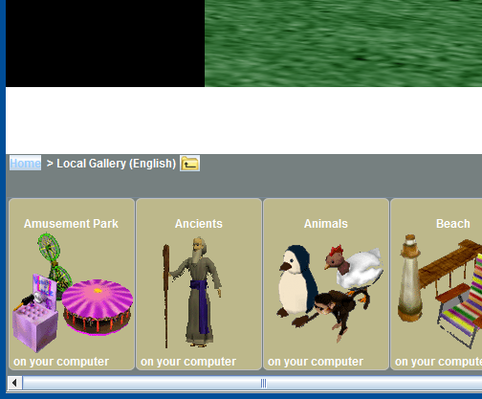
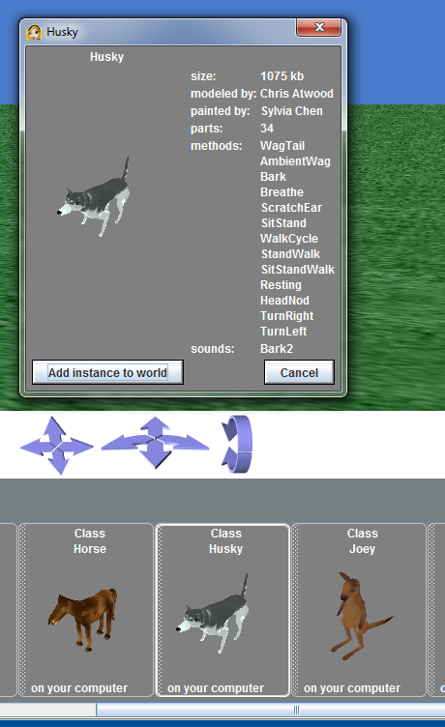
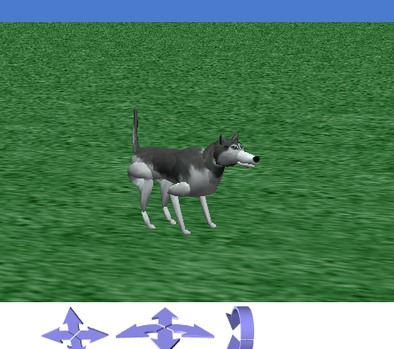
Step 1: Add Husky and Horse Model to the Alice World
Open the Object Gallery, see Lesson 0.
Find and open the “Animals” folder under the Local Gallery by clicking on it once.
Find the Husky, and click on it once to add it to the Alice world.
Alice will prompt you to verify that you want to add the Husky model to your Alice world. Click on “Add instance to World.
Notes:
Questions for students: What is a model? Answer: A model is the computer graphics equivalent of a physical object.

Slide 3
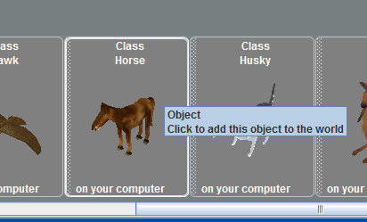
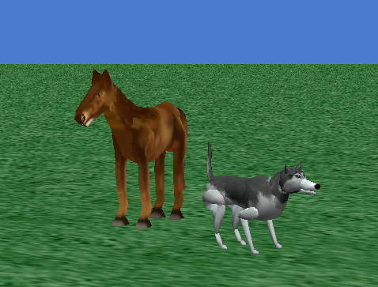
Step 2: Add Husky and Horse Model to the Alice World
Now find the “Horse” in the object gallery. Left-click, hold, and then drag the horse into your Alice world next to the husky.
Notes:
Questions for students: What is a model? Answer: A model is the computer graphics equivalent of a physical object.

Slide 4
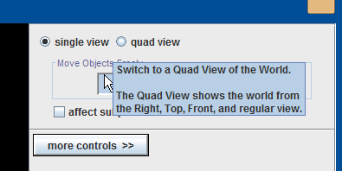
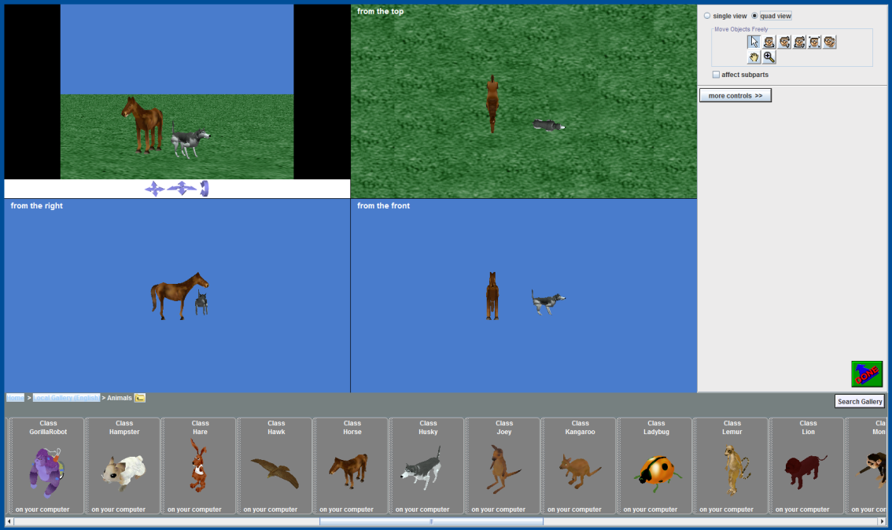
Step 3: Quad View
Click on the quad view radial button at the upper right hand corner of the screen.
Try moving the horse and the husky around in each view.
When you are done, be sure to restore the horse and the husky to their original positions. You can do this by clicking on the “Undo” button repeatedly until they are back in their original positions. If you click on “Undo” too many times, then you can restore a previous state by clicking on the “Redo” button.

Slide 5
In Class Exercise!
Notes:
Perform an in class exercise explaining axis. Be sure to point out concepts such as point-of-view.

Slide 6
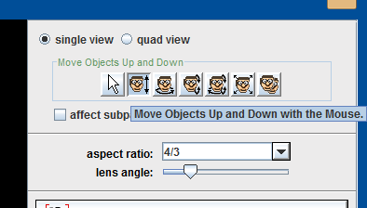
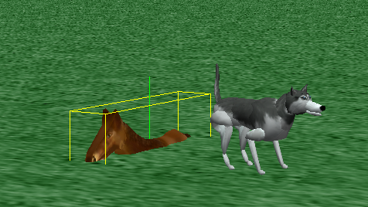
Step 4: Axis
Left click on the up-and-down motion button. This will allow you to move objects in your Alice world along the y-axis for your Alice world.
Left click on the Horse and drag it bellow the floor of the Alice world.
Observe the red, green, and blue axis for the horse. Observe the orientation of the horse as compared to the husky.
Notes:
Objects have three spatial dimensions: depth, width and height. Each model has a bounding box and has six degrees of freedom, or possible directions of motion: left, right, up, down, forward, and backward.
With respect to the axis; the green line is up, the blue line is forward, and the red line is right.

Slide 7
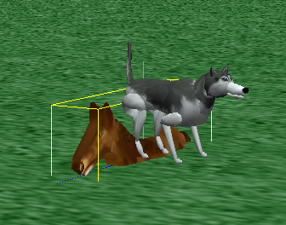
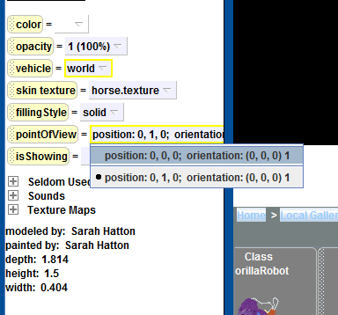
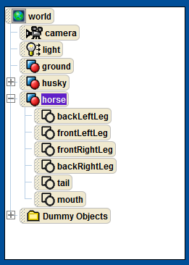
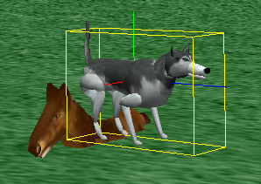
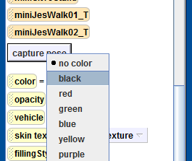
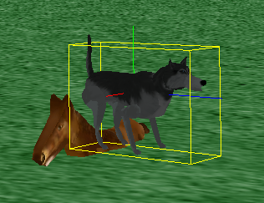
Step 5: Model Properties
Under the horse's details panel (see Lesson 0), change “pointOfView” property to the position (0,0,0).
Expand the horse model in the Alice object tree (see Lesson 0) by clicking on the square next to the horse model in the object tree.
Under the Husky’s properties (see Lesson 0), change the husky’s color to “black.”
Notes:
Setting the horse’s point of view to the center of the world will move the horse to the center of the student’s Alice world and align the horse’s axis with that of the Alice world.
With the horse model expanded, point out the various parts of the horse.

Slide 8
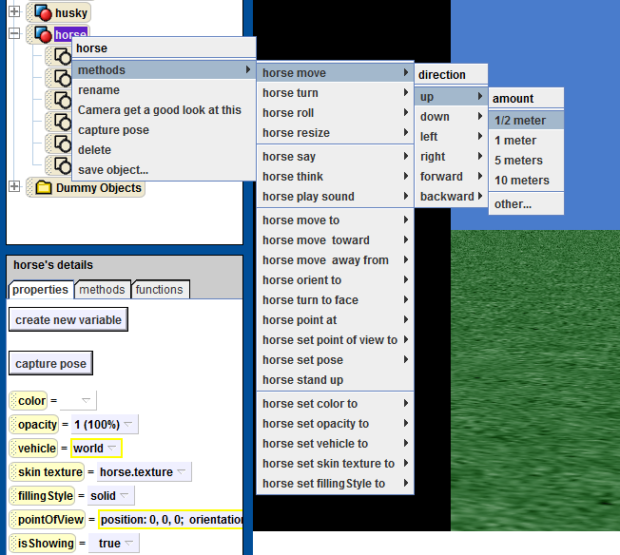
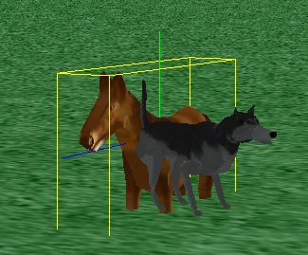
Step 6: Moving Models Functionally
Right Click on the “horse” in the Object Tree → choose methods → horse move → up → ½ meter.
Return the horse back to the center of the Alice world
Notes:
The horse can be re-centered by clicking on the “Undo” button or by setting it’s point-of-view to the origin of the Alice world: as in Step 3.

Slide 9
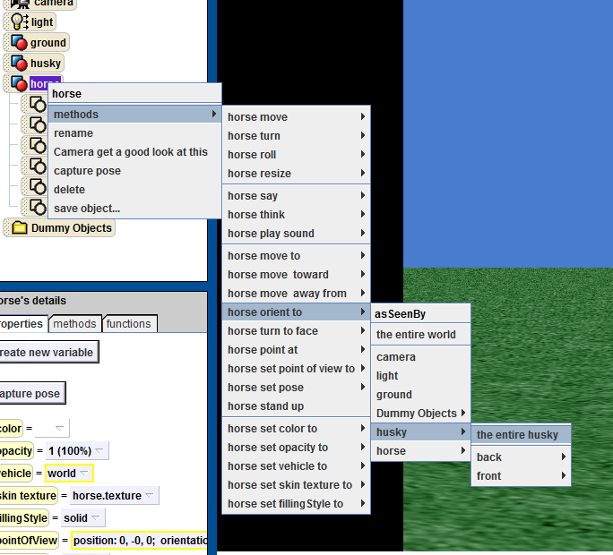
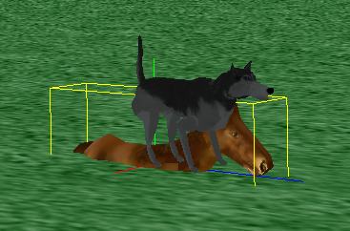
Step 7: Setting Model Orientation Functionally
Right Click on the “horse” in the World Window → choose methods → horse orient to → husky → the entire husky.
Undo the orientation change.

Slide 10
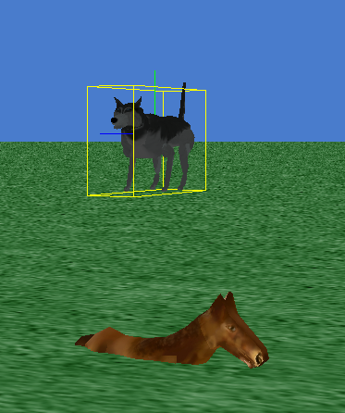
Step 8: Moving the Husky
Set the husky’s point of view to that of the Alice world (see Step 3).
Move the husky up 1.3 meters (see Step 4).
Return the husky back to its original position by pressing “Undo” twice.
Notes:
If you took more than two changes to your Alice world to move the husky to the final position then it may take you more undo-steps to return the husky back to its original position. If you press undo too many time, you can always redo your work by pressing the “Redo” button.

Slide 11
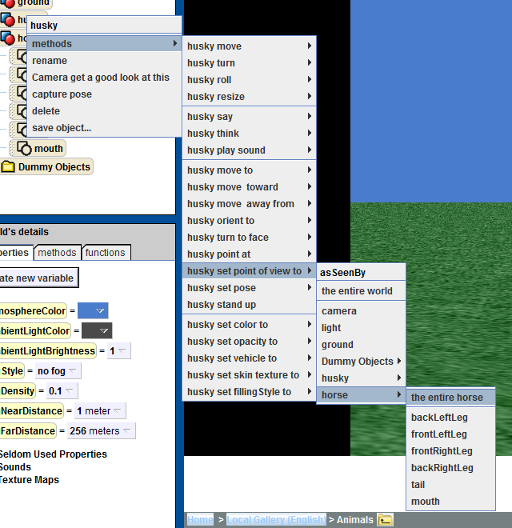
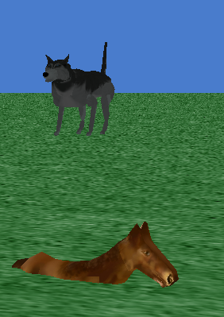
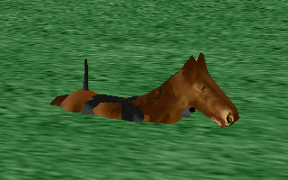
Step 9: Change the Husky’s Point-of-View
Right Click on the “husky” in the Object Tree → choose methods → husky set point of view to → horse →entire horse.
Undo the point-of-view change and return the husky to its original position.
Notes:
Ask the students: QUESTION: Does changing the point-of-view is the same as changing the moving the husky to the center of the world? ANSWER: no.
QUESTION: Why not? ANSWER: The orientation of the husky has also changed; whereas moving him to the center of the world would have only changed his location.
QUESTION: Why did the husky ended up at the center of the world?
ANSWER: The horse was centered at the center of the Alice world, and the “set point-of-view to” function centered the husky on the horse.

Slide 12
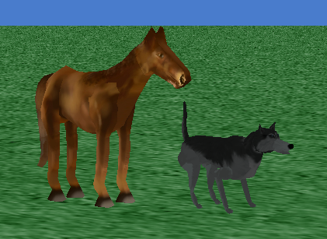
Step 10: Reposition the Scene
Use your mouse to move the horse to the left of the husky, and above the floor of the Alice world.

Slide 13
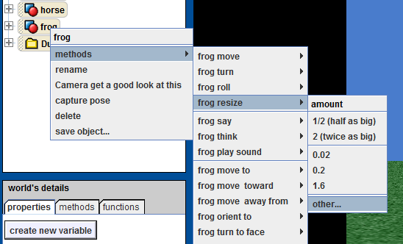
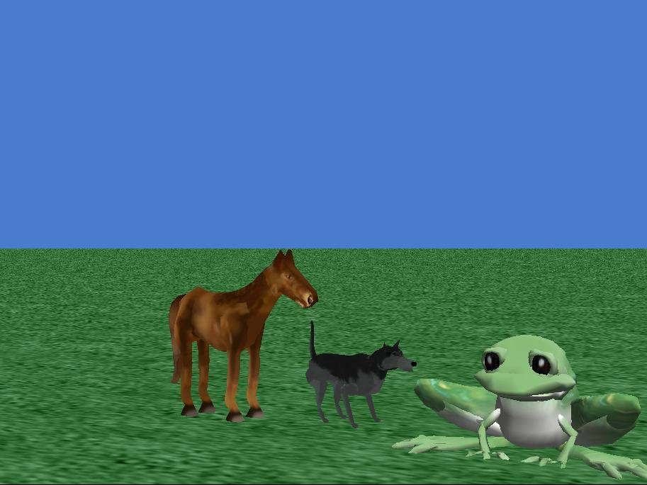
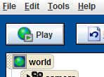
Step 11: First Program
Add a frog to our scene, move him to the left 2 meters, move him up .02 meters (see Step 4), and resize him 4 times as big.
Play your world by clicking on the “Play” button and the top left corner of your Alice IDE.
Notes:
When the students play their Alice world nothing should happen yet. Ask them:
QUESTION: Why doesn’t anything happen?
ANSWER: They have not written any instructions that tell Alice what is supposed to happen.
QUESTION: What kind of instructions have they provided Alice with?
ANSWER: They have given Alice graphical instructions on how to dynamically create and render their Alice world.

Slide 14
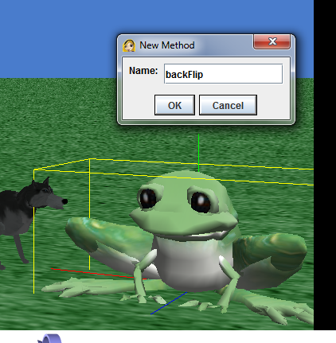
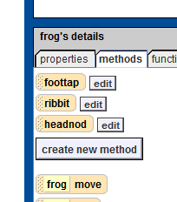
Step 12: Create a New Method for to Animate the Frog
Go to the methods tab in the frog’s details section of your screen (lower left corner).
Be certain that frog is highlighted in the object tree. Then, click the button, “create new method”. Enter “backFlip”.

Slide 15
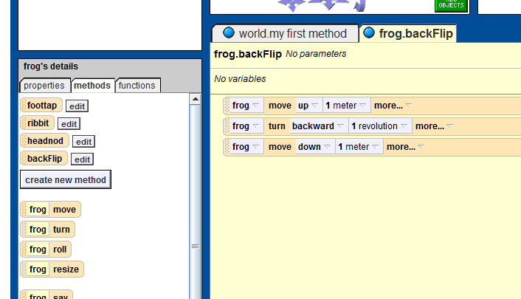
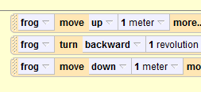
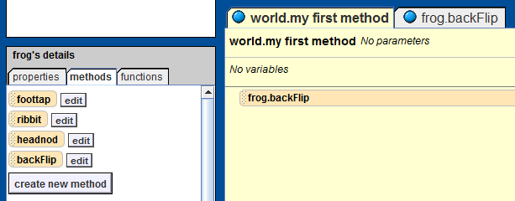
Step 13: Program a Jump Method for the Frog
Drag “frog move” method from frog details section into backflip.
Select up, select 1 meter.
Drag “frog turn” method from frog details section into backflip. Select backward, select 1 revolution.
Drag “frog move” method from frog details section into backflip. Select down, select 1 meter.
Click on world.my first method in the Code Editor Panel. Drag “frog.backFlip” method into my first method.

Slide 16
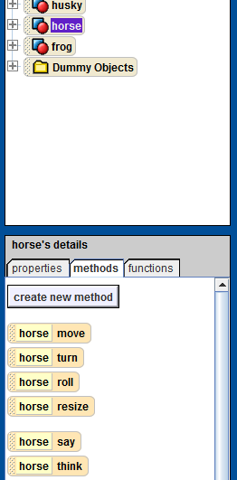
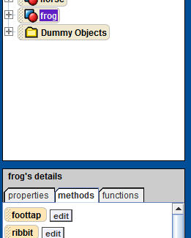
Step 14: Have the Horse Ask the Frog to Jump
Drag “horse say” method from horse details section and drop it between the “horse turn” method and the “frog.backflip” method. Say → other → “Do a back flip!”
Click on the “frog” in the Object Tree → Drag “frog.foottap” method from frog details section into “my first method” between the “horse say” method and the “frog.backflip” method.

Slide 17
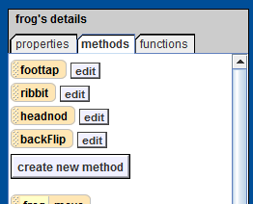
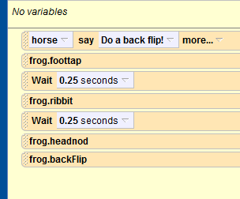
Step 15: Have the Frog Respond to the Horse
From the bottom of the screen, drag the wait .25 seconds.
Drag “frog.ribbit” method from frog details section into “my first method”.
From the bottom of the screen, drag the wait .25 seconds.
Drag “frog.headnod” method from frog details section into “my first method”.

Slide 18

Final Scene
Notes:
Now Play your world and see what happens!

